Slide 1

Flip Flops

Slide 2
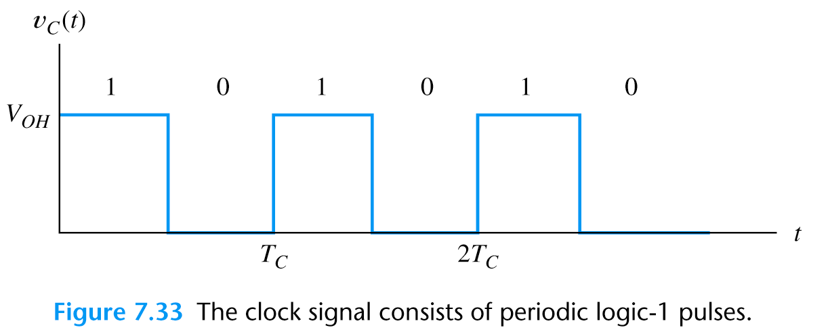
Clock Signal
Sequential logic circuits have memory
Output is a function of input and present state
Sequential circuits are synchronized by a periodic “clock” signal

Slide 3
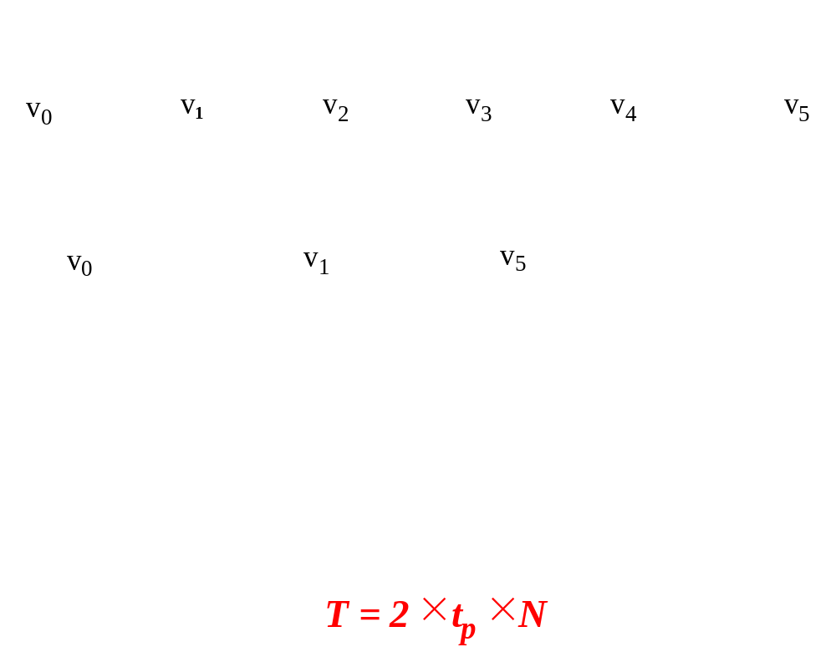
Clock Signal generator
Clock signals can be generated using odd number of inverters

Slide 4
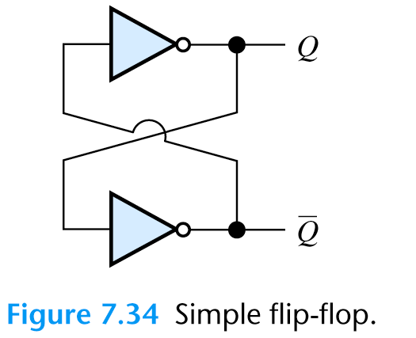
Flip Flop
A basic sequential circuit is a flip-flop
Flip-flop has two stable states of complementary output values

Slide 5
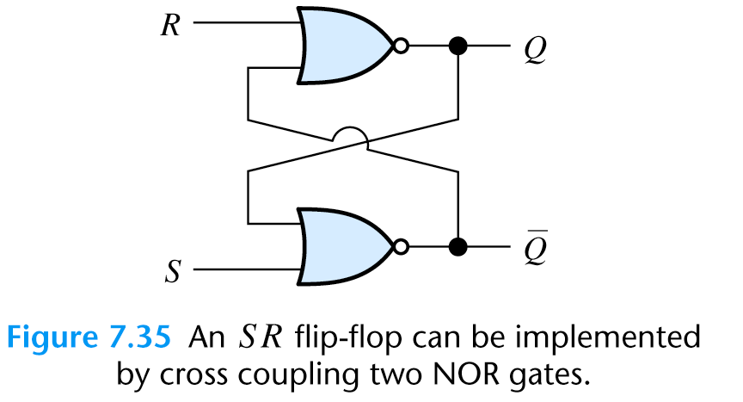
SR Flip Flop
SR (set-reset) flip-flop based on two nor gates

Slide 6
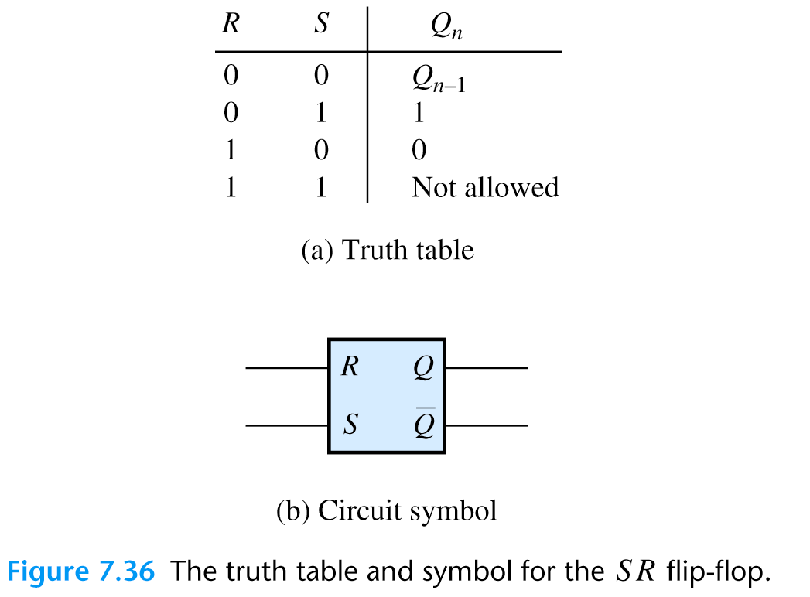
SR Flip Flop

Slide 7
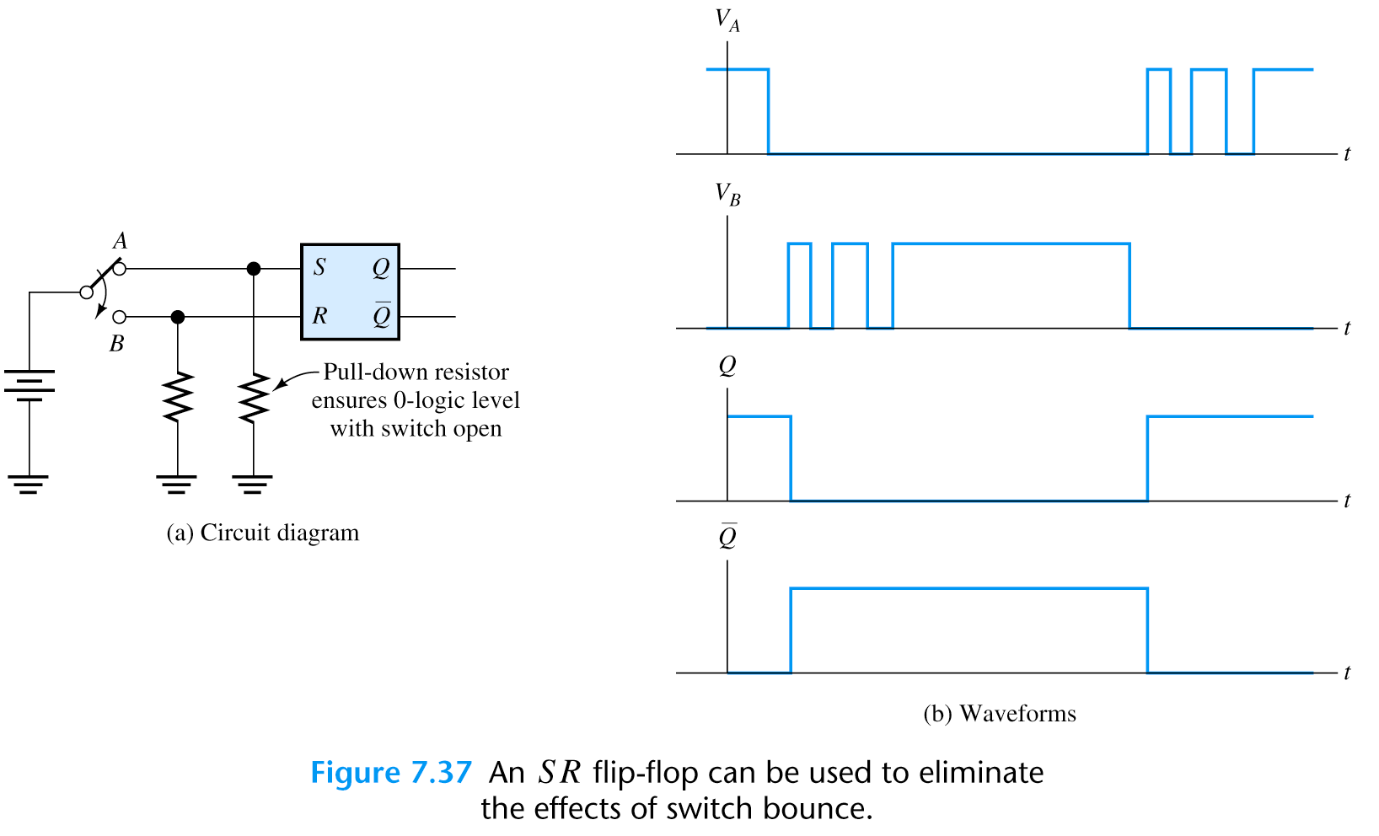
Noise Reduction in SR Flip Flop
SR flip flop can reduce a switching noise
When switch is pulled down some oscillations may occur at B
They will be eliminated by the flip-flop

Slide 8
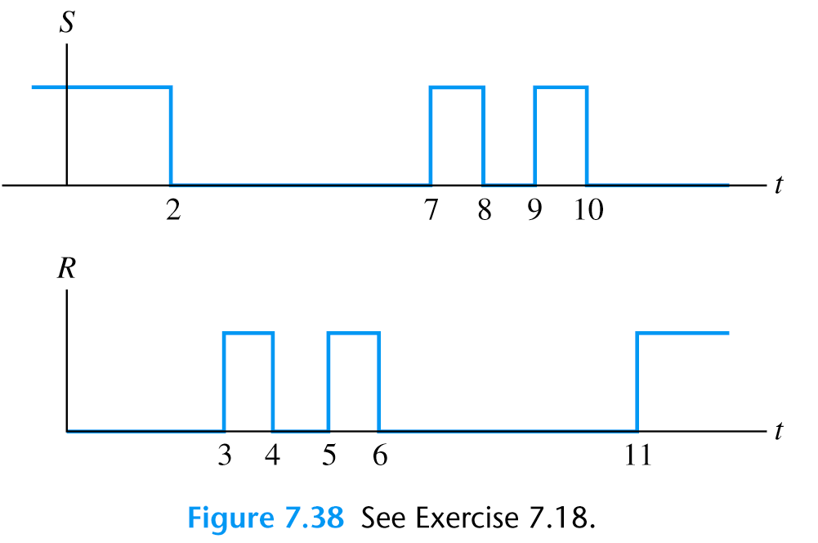
Exercise
For a given S and R inputs to SR flip-flop,
sketch the output signal Q
Q
t

Slide 9
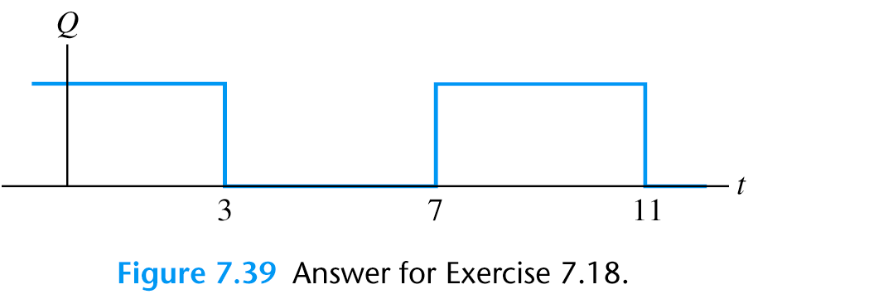
Exercise

Slide 10
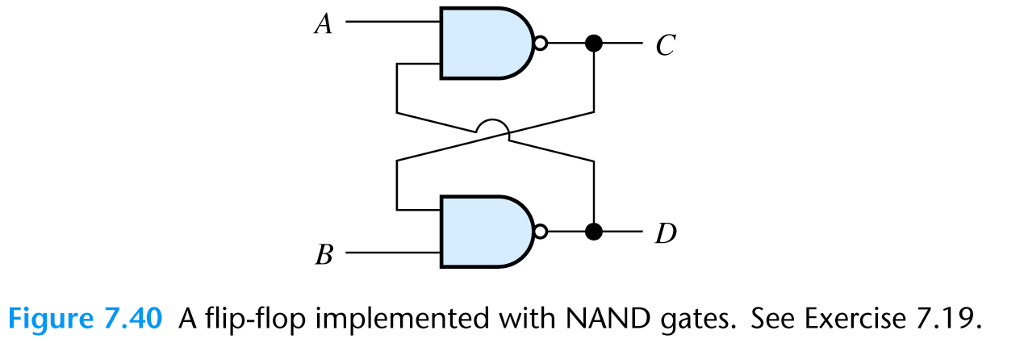
SR Flip Flop
SR (set-reset) flip-flop based on two nand gates

Slide 11
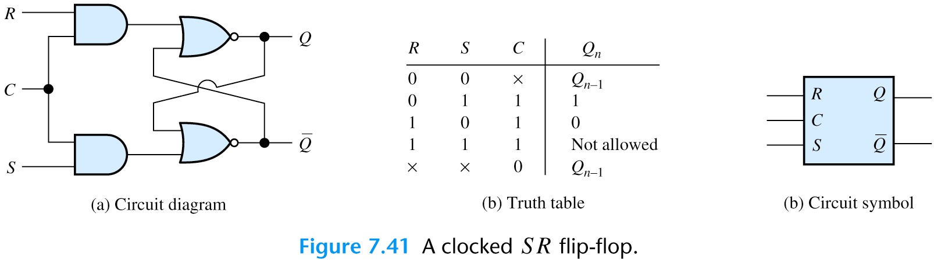
Clocked SR Flip Flop Circuit
Clock controlled flip-flop changes its state
only when the clock C is high

Slide 12
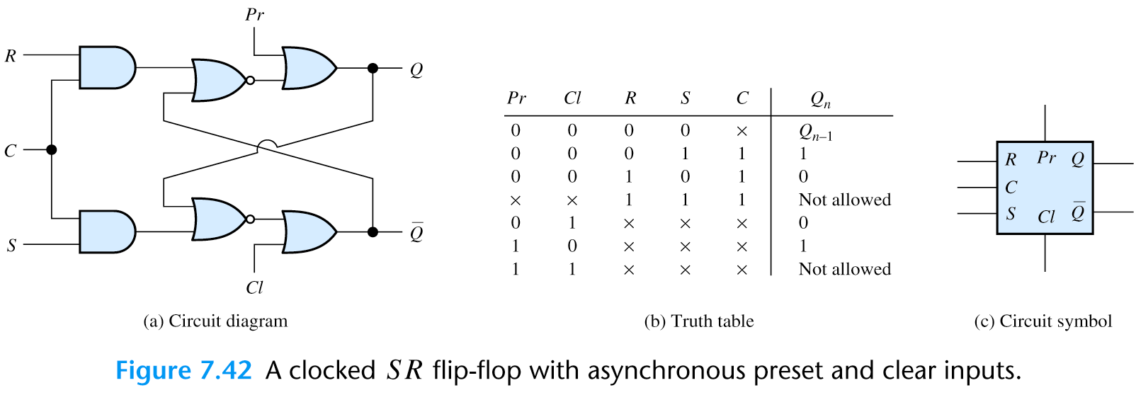
Clocked SR Flip Flop Circuit with Reset
Some flip-flops have asynchronous
preset Pr and clear Cl signals.
Output changes once these signals change, however
the input signals must wait for a change in clock
to change the output

Slide 13
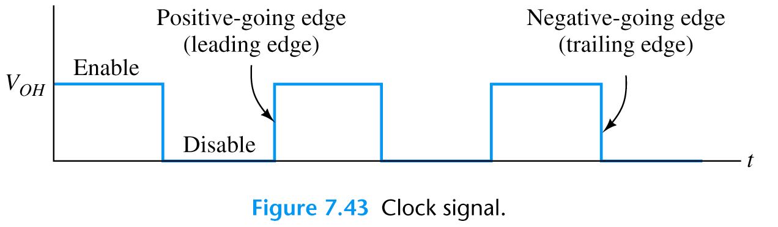
Edge Triggered Flip Flop
Edge triggered flip-flop changes only
when the clock C changes

Slide 14
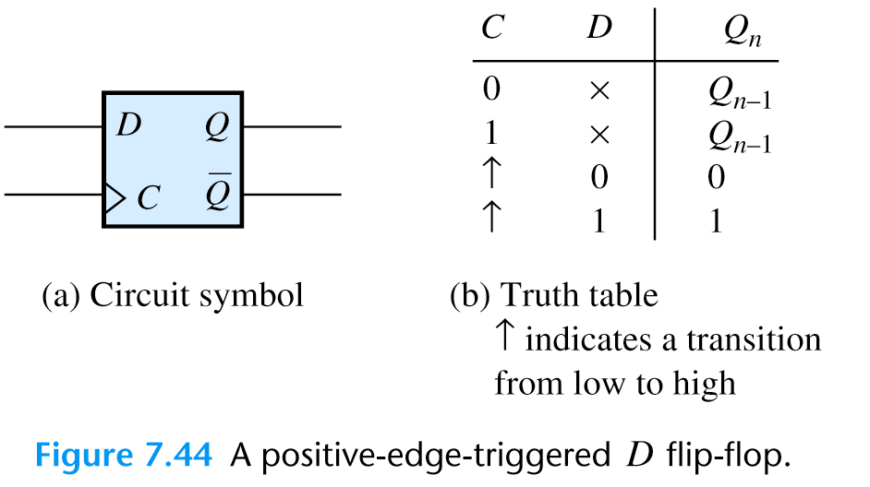
Positive Edge Triggered Flip Flop
Positive-edge triggered flip-flop changes only
on the rising edge of the clock C

Slide 15
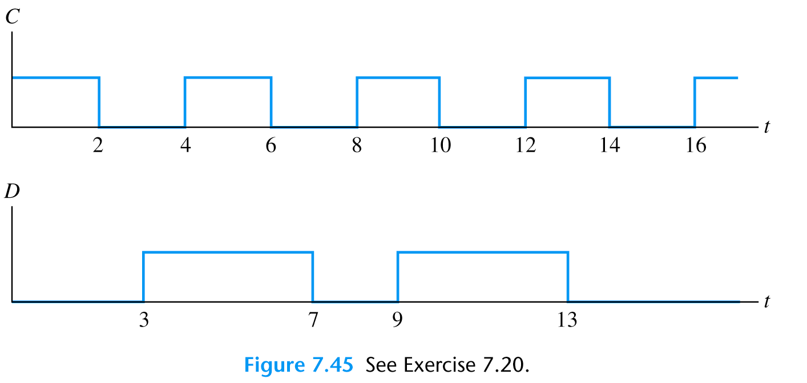
Exercise
The input D to a positive-edge triggered flip-flop is shown
Find the output signal Q
Q
t

Slide 16
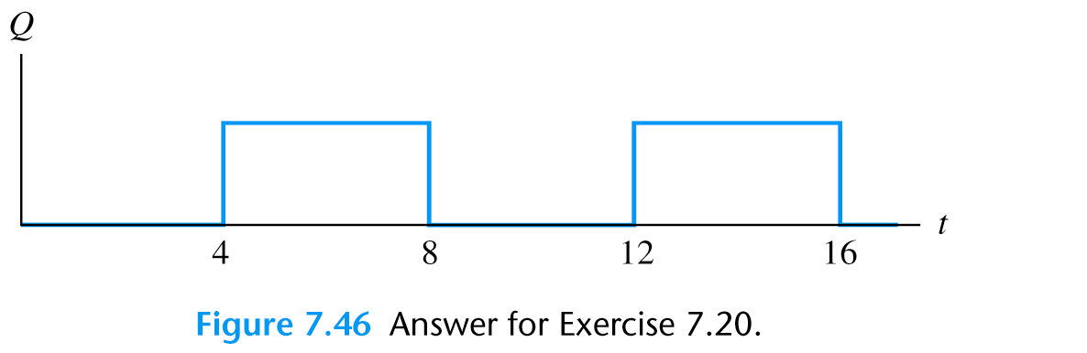
Exercise

Slide 17
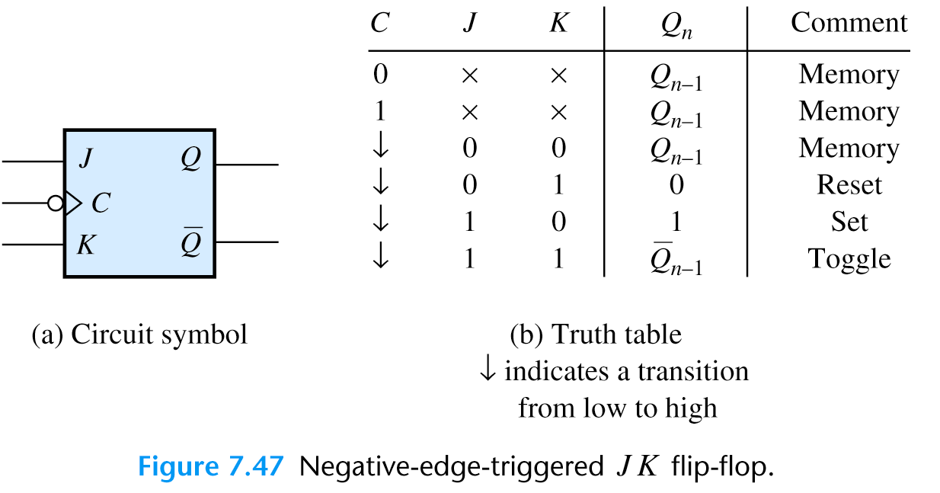
Negative Edge Triggered JK Flip Flop

Slide 18
Other Flip Flops
T
J
D
J
Q
Q
φ
φ
φ
φ
K
Q
K
Q
T
Q
D
Q
φ
Q
φ
Q
Toggle Flip-Flop
Delay Flip-Flop
(D-latch)

Slide 19
Race Problem
t
loop
t
φ
D
Q
t
1
φ
Q
Signal can race around during
φ
= 1

Slide 20
Master-Slave Flip Flop Implementation
MASTER
SLAVE
J
S
Q
SI
S
Q
Q
K
R
Q
RI
R
Q
Q
φ
Master transmits the signal
to the output during the
high clock phase and
slave is waiting for the
clock to change this
prevents race conditions
PRESET
J
Q
φ
K
Q
CLEAR

Slide 21
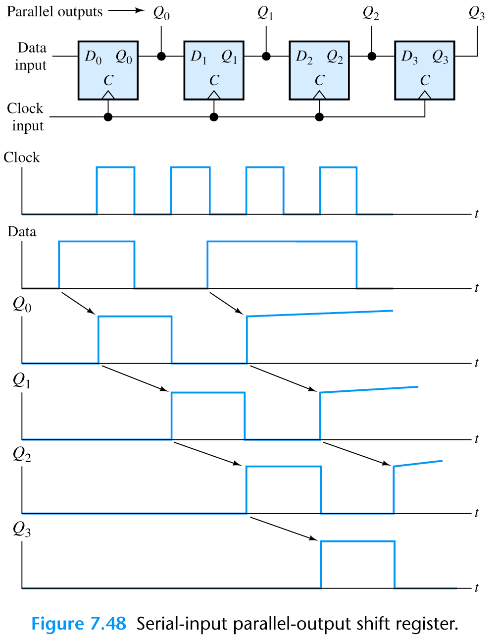
Shift Registers

Slide 22
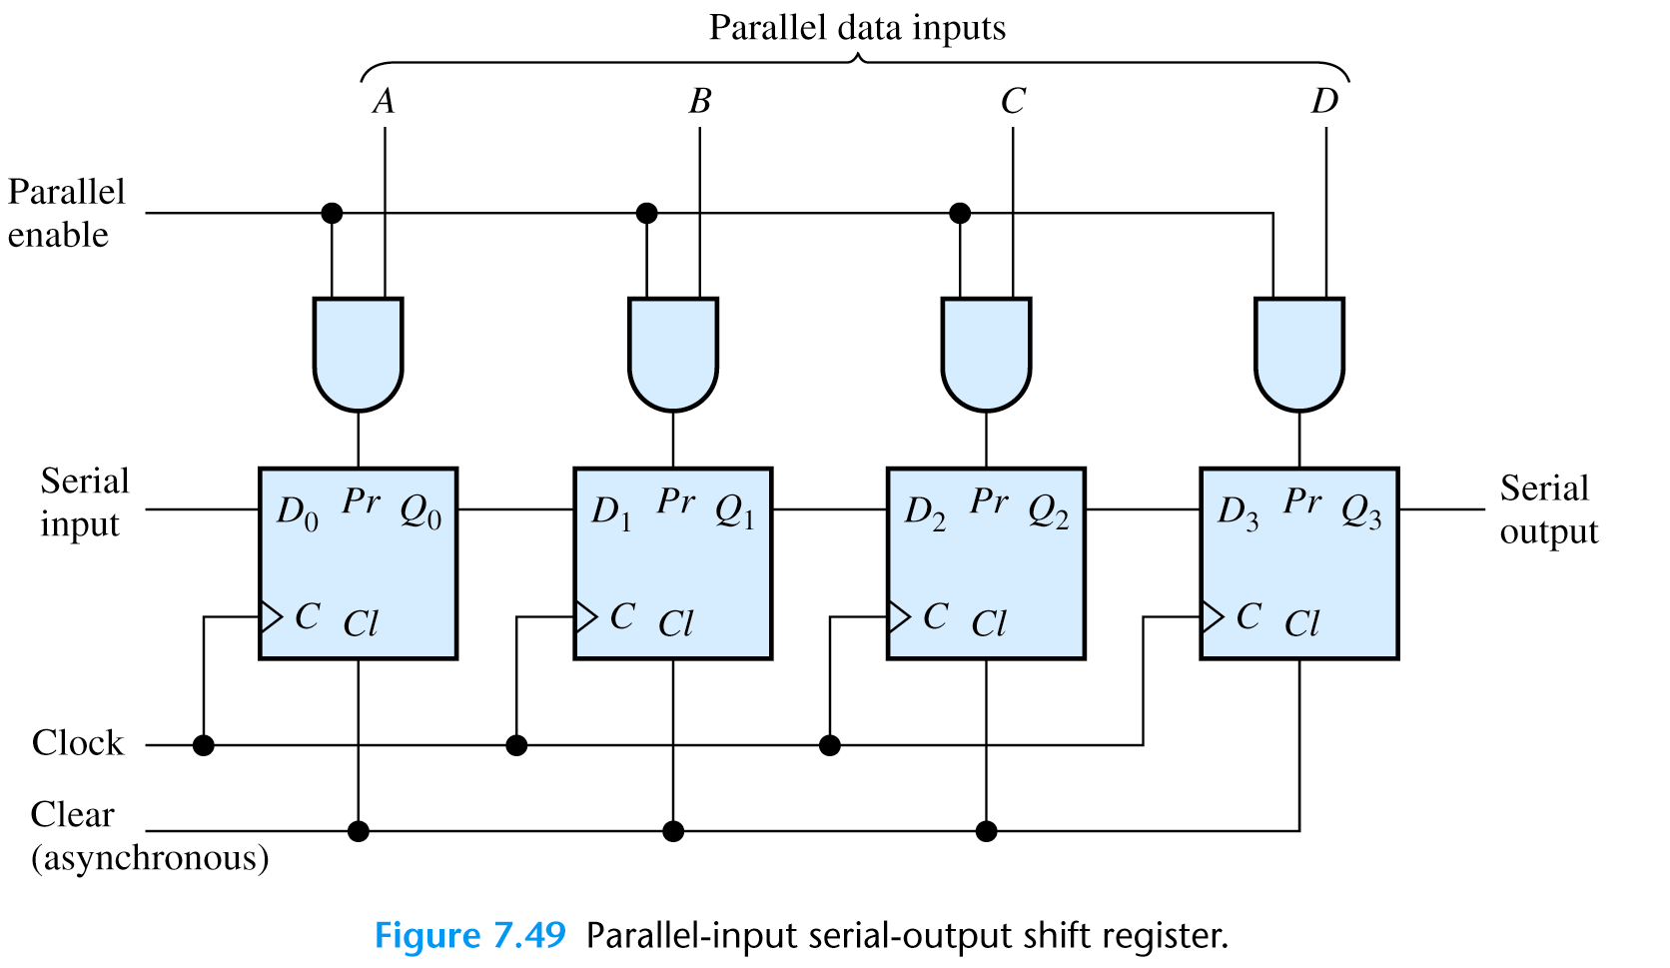
Shift Registers

Slide 23
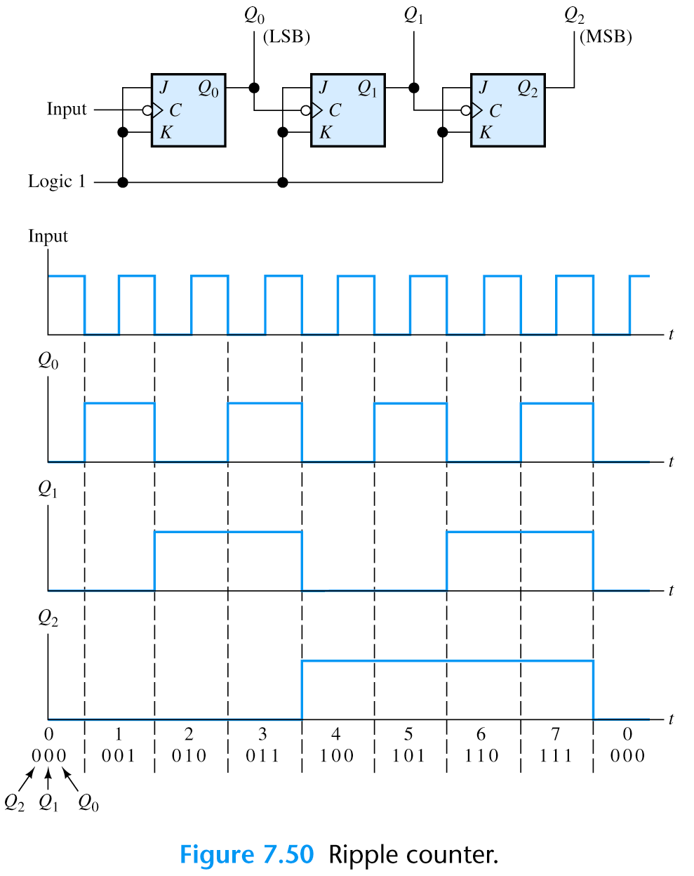
Counter

